Slide 1

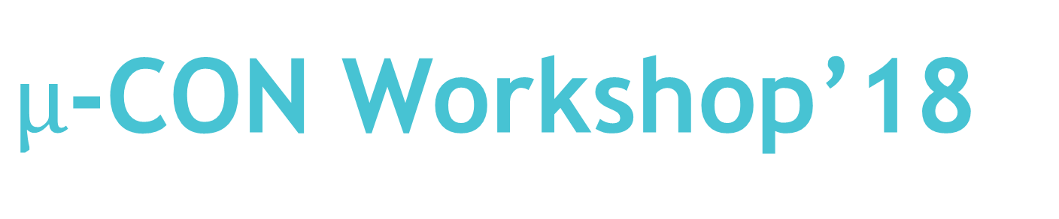
$µ$-CON Workshop’18
“ Wireless Game Controller
Using Infrared Data Transmission ”

Slide 2
Session 6: Python Integration
1st Oct’18, 17:00 to 20:00 Hrs.

Slide 3

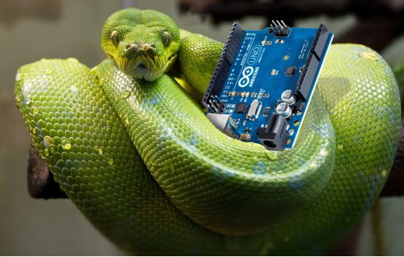
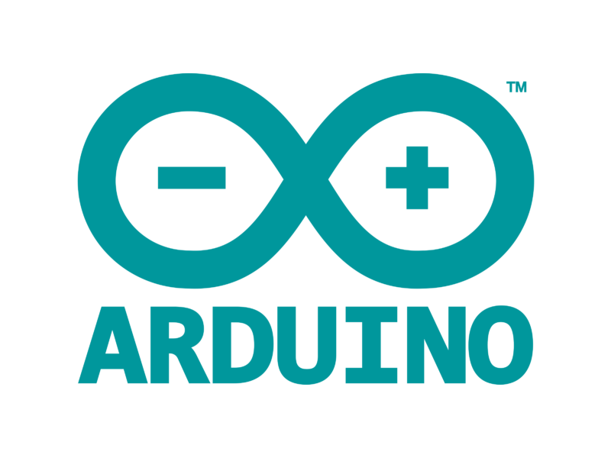

Slide 4
Python: An overview
Python is an interpreted high-level programming language for general-purpose programming. Created by Guido van Rossum and first released in 1991.
It is one of the most widely used scripting language and known for its simplicity in learning and coding.

Slide 5
Few features of Python:
Broad Standard Library – Python has a bulk library and is very portable and cross platform compatible.
Portablity - Python can run on a wide variety of hardware platforms and has the same interface on all platforms.
Database Support - Python provides interfaces to all major commercial databases.

Slide 6
Syntax:
Lines and Indentation: Python provides no braces to indicate blocks of code for class and function definitions or flow control. Blocks of code are denoted by line indentation, which is rigidly enforced.
Identifiers

Slide 7
Data types:
Python has five standard data types −
Numbers
String
List
Tuple
Dictionary
We shall be needing the numbers, strings and lists for this workshop. Each data type has it’s own functions and properties. Explaining them is beyond the scope of this event.

Slide 8
Control Flow:
If, else if and else conditions:
if(condition1):
#do something
elif(condition2):
#do something
else:
#do something

Slide 9


Control Flow (Contd..):
Looping:
For loop:
While loop:

Slide 10

Modules to be used:
Pyserial – For interpreting the serial data from arduino
Pynput – For emulating the key presses without manually pressing keys
Modules are to be imported before using in the code. It can be done
by the command ‘import module_name’
Eg. import serial

Slide 11
Key Press Function:
Key press function helps us to initiate virtual press of a key.
Example:
---> keyboard.press(Key.space)
keyboard.release(Key.space)
---> keyboard.press(‘A’)
keyboard.release(‘A’)
Note: When keyboard.press function is used the respective key remains pressed until keyboard.release is used.

Slide 12
Let’s code:
Write a code to implement virtual typing:
import time
from time import sleep
from pynput.keyboard import Key,Controller
keyboard = Controller()
keyboard.press(‘S')
keyboard.release(‘S')
sleep(2)
keyboard.press(‘P')
keyboard.release(‘P')
sleep(2)
keyboard.press(‘I')
keyboard.release(‘I')
sleep(2)
keyboard.press(‘D')
keyboard.release(‘D')
sleep(2)
keyboard.press(‘E')
keyboard.release(‘E’)
sleep(2)
keyboard.press(‘R')
keyboard.release(‘R')

Slide 13
Was it the same as printing a string??
NO. When you print a string it just gets printed in your output screen, but when you initiate a virtual keypress the keyboard sends a signal to the CPU.
And guess how it is going to be useful for us?
We can control applications and games without even touching the keyboard.

Slide 14
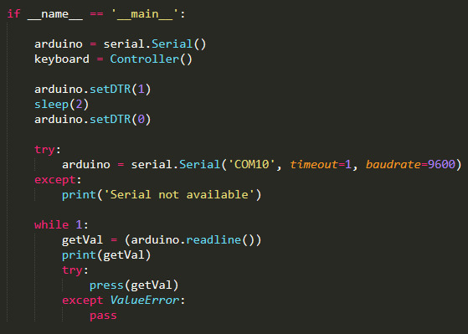
Let’s jump in to our main code:
We are calling our main function first and creating class objects for serial data transmission and keyboard controller.
Then we are resetting the arduino to start data reception from beginning to avoid any errors.
Later we get the serial data from the usart and print the received data.
We also call the press function for pressing the keys.

Slide 15
Thank You

